Slide 1
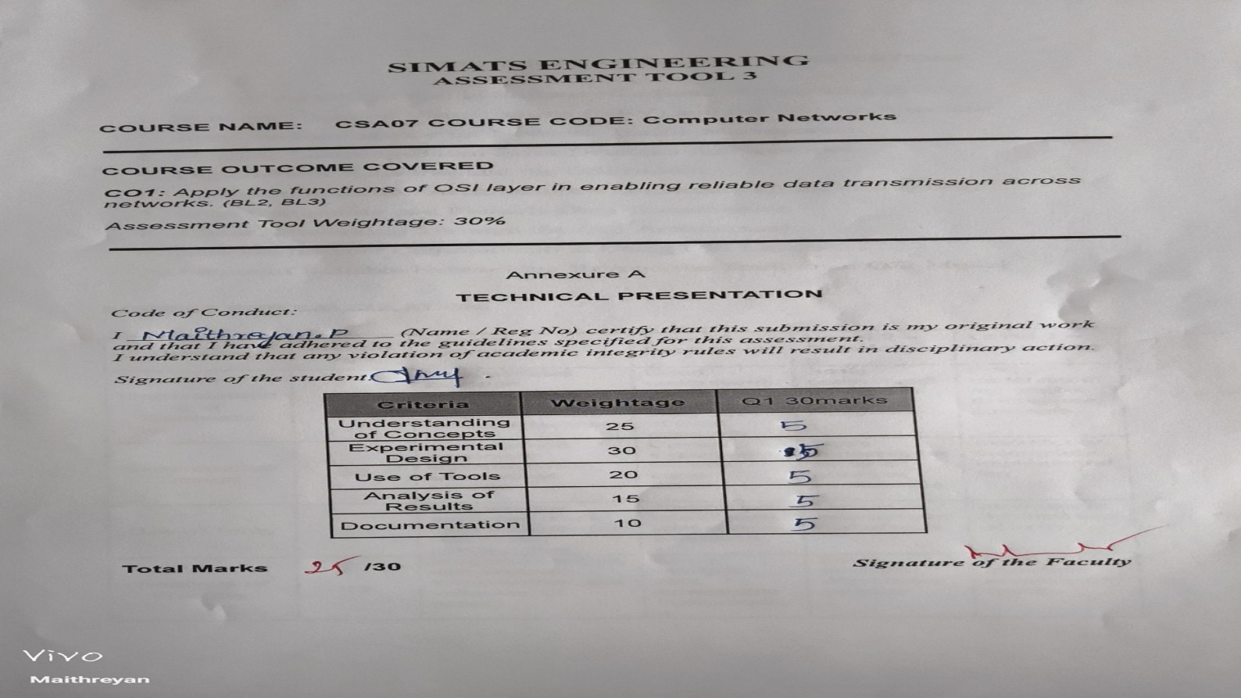

Slide 2
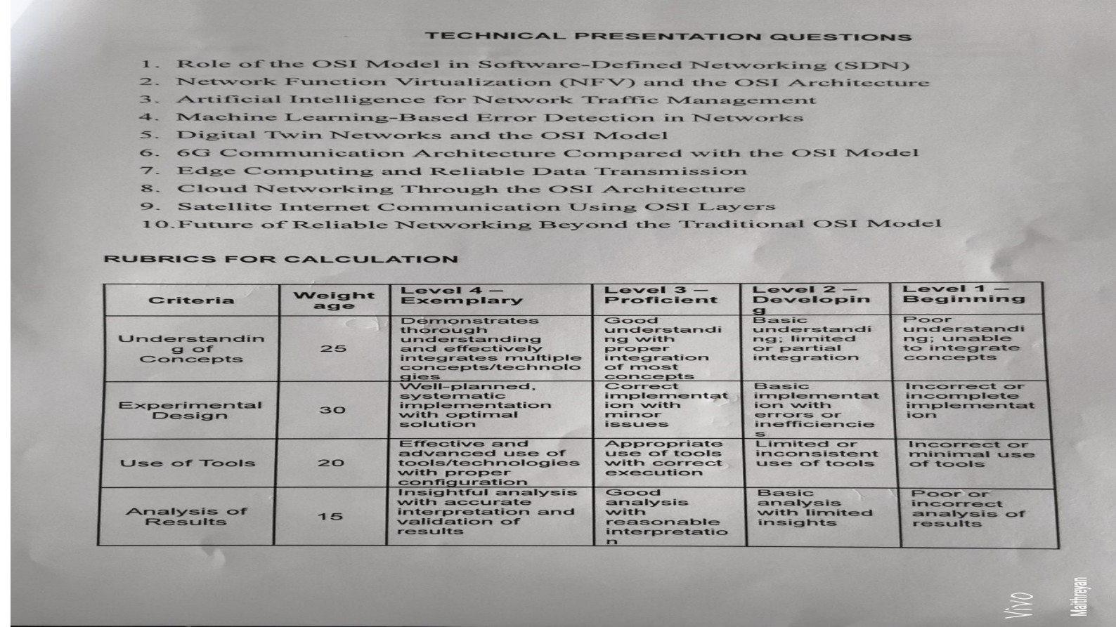

Slide 3


Slide 4
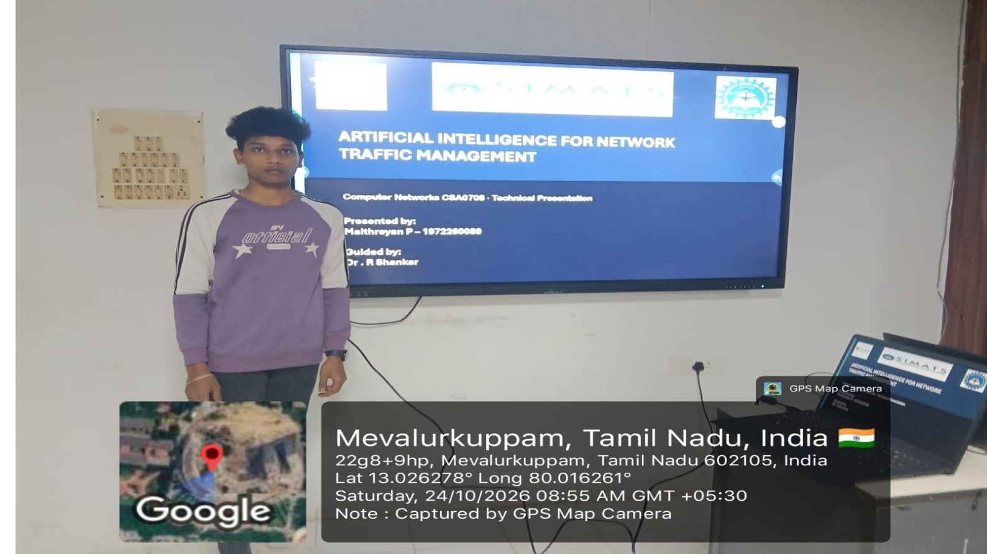

Slide 5
ARTIFICIAL INTELLIGENCE FOR NETWORK
TRAFFIC MANAGEMENT
Computer Networks CSA0708 · Technical Presentation
Presented by:
Maithreyan P 1972260089
Guided by:
Dr R Shankar

Slide 6
Introduction
Computer networks carry many types of data every day.
Traffic includes video, voice calls, websites and file transfers.
Fixed network rules may not respond quickly to changing demand.
AI can help networks understand traffic and manage it automatically.
SAY: This presentation explains how AI helps networks classify, predict and manage traffic.
02

Slide 7
Problem with Traditional Management
Static rules cannot easily adapt to changing traffic.
Network teams often react only after congestion or failures occur.
Cloud, IoT, video and 5G make traffic more complex.
Encryption makes it harder to inspect message contents.
These issues can cause delays, wasted capacity and slow recovery.
SAY: Traditional systems often respond after a problem has already affected users.
03

Slide 8
What Is AI Traffic Management?
AI studies network data to find patterns.
It can identify different types of traffic.
It can predict when a link may become busy.
It can suggest better routes and traffic priorities.
The network measures results and adjusts again.
SAY: AI makes traffic management more predictive instead of only reactive.
04

Slide 9
How the AI System Works
1. Observe: collect traffic, queue and delay information.
2. Learn: find patterns and unusual activity.
3. Decide: choose routes, rates and priorities.
4. Act: send the chosen rules to network devices.
The system repeats this cycle using new measurements.
SAY: The main cycle is observe, learn, decide and act.
05

Slide 10
Main AI Techniques
SUPERVISED
UNSUPERVISED
Classifies traffic
Finds unusual activity
TIME SERIES
REINFORCEMENT
Predicts traffic load
Learns routing choices
SAY: Different AI methods are used for different network tasks.
07

Slide 11
Use Case 1: Classification and Detection
Classification identifies traffic such as video, voice and web use.
Traffic can be recognised using flow patterns like size and timing.
Anomaly detection learns what normal traffic looks like.
It can flag unusual spikes, port scans or possible DDoS activity.
This helps the network apply priorities and raise alerts faster.
SAY: Classification helps prioritise traffic, while anomaly detection helps spot unusual activity.
08

Slide 12
Use Case 2: Prediction and Routing
AI models can forecast future link load.
Traffic can be moved before congestion becomes severe.
Routing methods can choose paths with lower delay and packet loss.
Load balancing spreads traffic across links or servers.
Reinforcement learning is usually tested in simulation first.
SAY: Prediction and routing work together to reduce congestion.
09

Slide 13
System Architecture
APPLICATION PLANE
Traffic engineering • QoS • Security
Telemetry flows up to the AI engine.
Routes and QoS rules flow back down.
CONTROL PLANE
SDN controller + AI engine
DATA PLANE
Switches and routers forward packets
SAY: The AI engine can work beside a software-defined networking controller.
10

Slide 14
Challenges and Limitations
Data may be incomplete, limited or out of date.
AI decisions must be made quickly enough for network traffic.
Operators need to understand why a route was changed.
Attackers may try to fool AI models.
Traffic patterns change, so models may need retraining.
Incorrect automated actions can interrupt service.
SAY: AI needs monitoring and safe fallback rules before wide use.
11

Slide 15
Future Scope
Intent-based networking: users state goals and AI helps configure the network.
Federated learning: models learn across networks without sharing raw traffic.
AI-based management can support 5G and future 6G networks.
Explainable AI can help operators understand decisions.
Safer testing and retraining can improve reliability.
SAY: Future systems aim to be more adaptable, explainable and safe.
12

Slide 16
Conclusion and References
AI can make network management predictive and adaptive.
It can classify traffic, detect anomalies, forecast load and improve routing.
Data quality, speed, explainability and safety remain important.
References: Boutaba et al., “A comprehensive survey on machine learning for networking” (2018).
Mestres et al., “Knowledge-Defined Networking” (2017).
Thank you — any questions?
SAY: The key message is that AI can improve traffic management when it is used carefully.
13

